Slide 1


Slide 2
COMBINATION
Definition:
The combination is defined as “an arrangement of objects where the order in which the objects are selected does not matter.”
The combination means “selection of things," where the order of things has no importance.
Combinations can be divided into two categories:
Repetition is permitted: such as with coins in your pocket (2, 5, 5, 10, 10).
Repetition is not permitted: lottery numbers, for example (2, 14, 18, 25, 30, 38).

Slide 3
^{FORMULA}
^{n}C_{r} = n!/r!(n-r)!, when n>r
^{n}C_{r} = 0 , when n<r
^{n}C_{n} = 1
^{n}C₀ = 1
^{n}C_{r} = ^{n}Cn-1 ; this is true if r = 1 or r = n-1
Where,
n = distinct object to choose from
C = Combination
R = spaces to fill (Where r can be replaced by k also)
Notes:
=> combination – selection
A, B, C -> pick 2 letters to form a 2-letter word
AB
AC
BC => here, AB = BA
=> selection -> whereas in permutation
AB BA
AC CA
BC CB
=> 6 ways

Slide 4
formula: 1
nC_x = nC_y ➔ x = y; x + y = n
e.g.: 15C_3 = 15C_12
1) 15C_3 = 15C_12
2) 7C_2 = 7C_5 ➔ 7 x 6 = 7 x 6 x 5 x 4 x 3 / 1 x 2 x 3 x 4 x 5
3) 8C_6 = 8C_2
4) 15C_7 = 15C_8
5) 15C_9 = 15C_6

Slide 5
formula: 2
=> n person in the hall every person shakes his hand with every other only once, total handshake. ➔ nC 2 = n(n-1) / 2
=> Gifts shares to another person ➔ n(n-1)
=> no. of diagonal in a polygon of n sides ➔ nC2 - n
Triangle:
3C2 = 3 x 2 /1 x 2 – 3 ➔ 0 ➔ no diagonal
Rectangle:
4C2 – 4 ➔ 4 x 3 / 1 x 2 - 4 = 6 – 4 ➔ 2 ➔ 2 diagonal

Slide 6
Formula 3 :
➔ if there are 'n' non-collinear points in a plane, then
a) no. of st. lines formed = nC2
b) no. of triangles formed = nC3
c) no. of quadrilaterals formed = nC4
Formula 4 :
➔ if there are 'n' points in a plane out of which 'm' are collinear, then
a) no. of st. lines formed = nC2 - mC2 + 1
b) no. of triangles formed = nC3 - mC3
Notes:
Ex:
➔ 10 points in thart 4 are collinear ,find no. of st. lines made by these points ➔ 10c2-4c2+1
➔ In a plane there are 11 pts, out of which 5 are collinear. Find no. of triangles made by these pts.
Soln:
nC3 - mC3 = 11C3 - 5C3
= (11 x 10 x 9) / (1 x 2 x 3) - (5 x 4 x 3) / (1 x 2 x 3)
= 165 - 10
= 155

Slide 7
The Use of Permutation and Combination in Daily Life
Application Areas of Combinatorics
Computer architecture
Computational molecular biology
Languages
Pattern analysis
Scientific discovery
Databases and data mining
Operations research
Accumulation of electronic communication data
Homeland security
Simulation

Slide 8
Question 1
Question 1
There are 3 candidates for a classical, 5 for a mathematical, and 4 for a natural science scholarship. In how many ways can these scholarships be awarded (one scholarship per subject)
A)
60
B)
30
C)
15
D)
20
Notes:
Answer : A) 60

Slide 9
ANSWER
Scholarships are one per subject
3 candidates for classical
5 candidates for mathematical
4 candidates for natural science
Total ways 3C1×5C1×4C1
=3×5×4
=60

Slide 10
Question 2
There are 12 people in a party. If each of them shakes hands with each other, then how many handshakes are there in the party?
54
72
66
75
Notes:
Ans: C) 66

Slide 11
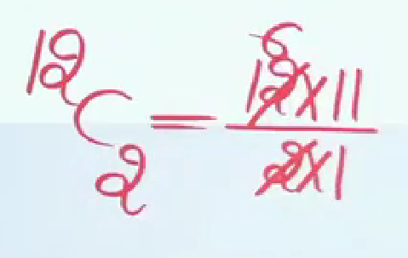
ANSWER

Slide 12
Question 3
There are 11 people in a party and if each of them hugs with each other, how often do they hug?
55
56
64
None of these
Notes:
Ans : A) 55

Slide 13
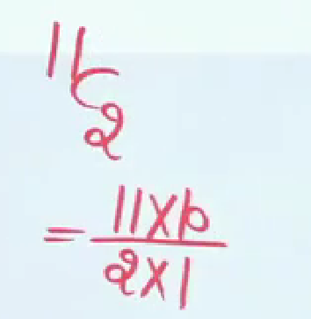
ANSWER

Slide 14
Question 4
A total of 28 handshakes were exchanged at the conclusion of a
party. Assuming that each participant was equally polite towards all the others, the number of people present was:
14
7
9
8
Notes:
Ans: D) 8

Slide 15
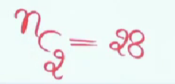
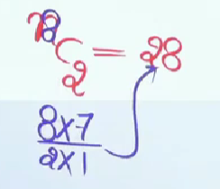
ANSWER

Slide 16
Question 5
On a new year day every student of a class sends a card to every other student. The postman delivers 600 cards. How many students are there in the class?
25
20
30
60
Notes:
Ans: A) 25
n(n-1) =600
n^2-n-600=0
(n-25)(n+24)=0
N=25 ,-24
N=25

Slide 17
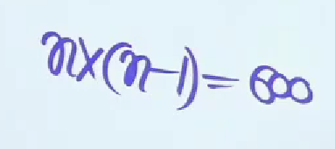
ANSWER

Slide 18
Question 6
There are 10 points on a surface 4 of them are linear. How many triangle be formed from these points?
120
110
114
116
Notes:
Ans : D) 116

Slide 19
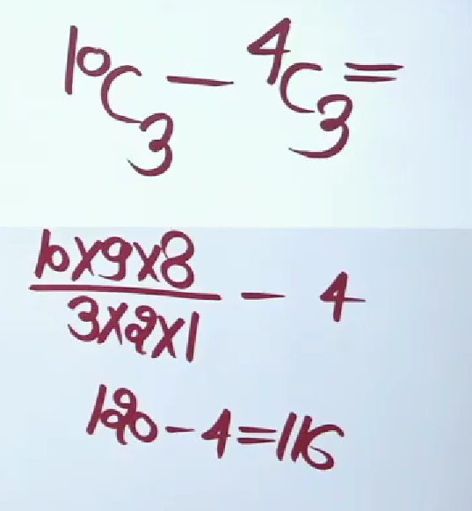
ANSWER

Slide 20
Question 7
In how many ways can a student choose a programme of 5 courses if 9 courses are available and 2 specific course are compulsory for every student?
25
35
70
65
Notes:
Ans: B) 35

Slide 21
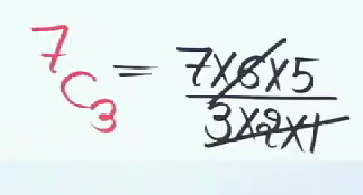
ANSWER

Slide 22
Question 8
In how many ways can one select a cricket team of eleven from 17 players in which only 5 persons can bowl if each cricket team of 11 must include exactly 4 bowlers ?
3960
4040
5100
3850
Notes:
Ans: A) 3960

Slide 23
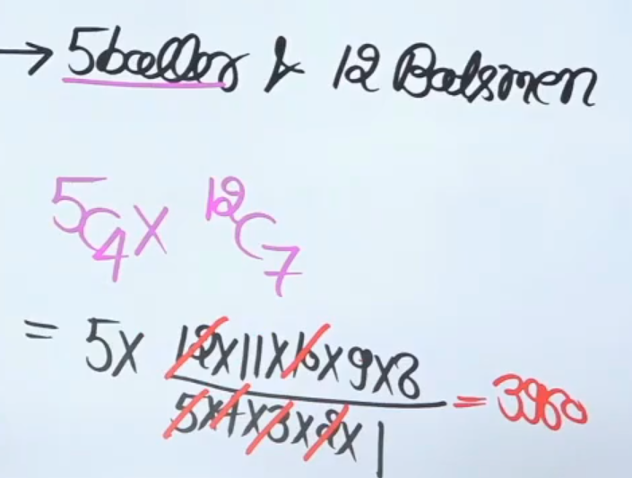
ANSWER

Slide 24
Question 9
The number of ways in which a team of 11 players can be selected from 22 players including 2 of them and excluding 4 of them is.
16 C 6
16 C 7
16 C 8
20 C 7
Notes:
Ans : B) 16 C 7

Slide 25
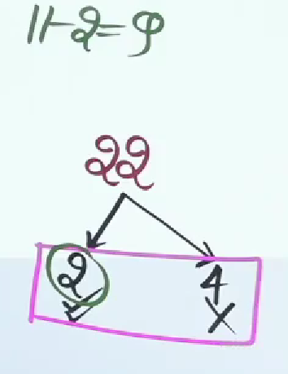
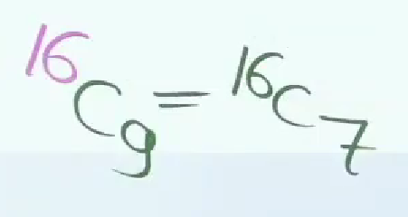
ANSWER

Slide 26
Question 10
In a touring cricket team there are 16 players in all including 5 bowlers and 2 wicket-keepers. How many teams of 11 players from these, can be chosen, so as to include three bowlers and one wicket keeper?
650
720
750
640

Slide 27
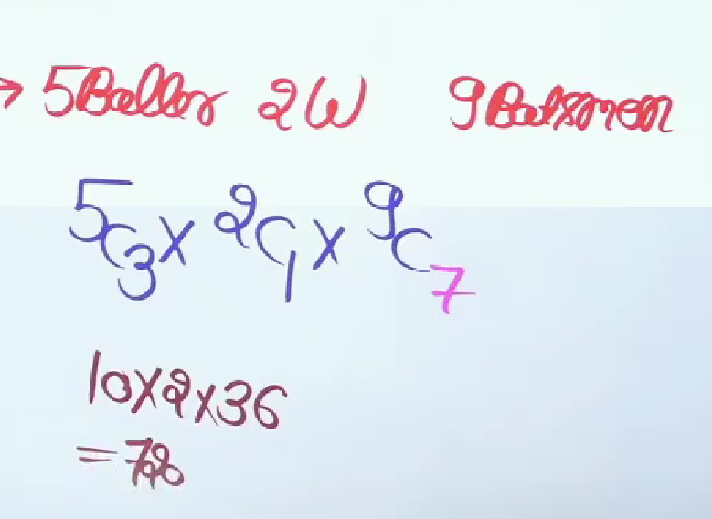
ANSWER

Slide 28
Question 11
In the 13 cricket players 4 are bowlers, then how many ways can form a cricket team of 11 players in which at least 2 bowlers included?
55
72
78
76
Notes:
Ans : c) 78

Slide 29
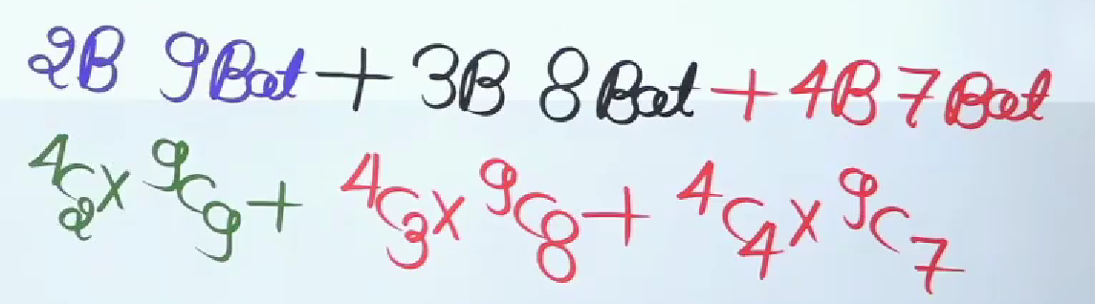
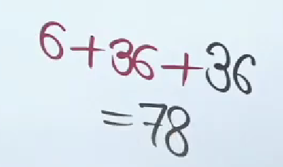
ANSWER

Slide 30
Question 12
A group consists of 4 girls and 7 boys. In how many ways can a team of 5 members be selected?
A) if the team has no girl.
B) At least one boy and one girl?
C) At least 3 girls?
Notes:
Ans: A) 21
B) 441
C) 91

Slide 31
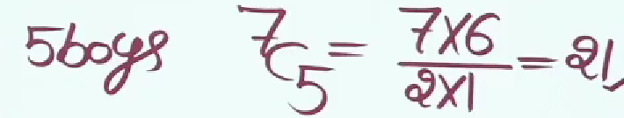
ANSWER

Slide 32
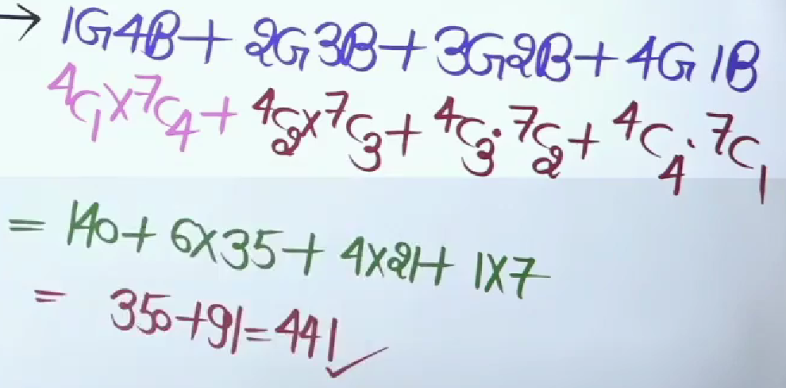
ANSWER

Slide 33
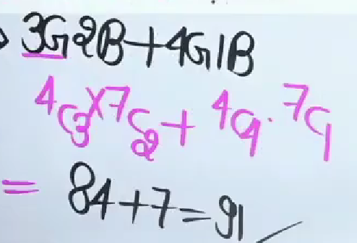
ANSWER

Slide 34
Question 13
In how many ways can 6 persons be selected from 4 officers and 8 constables, if at least one officer is to be included?
224
672
896
576
Notes:
Ans: C) 896

Slide 35
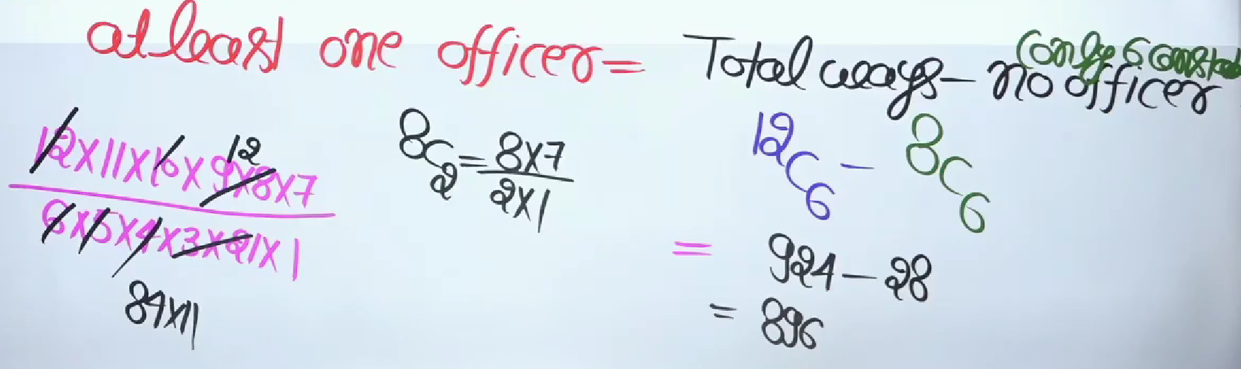
ANSWER

Slide 36
Question 14
In how many ways 4 children can be selected from a group of 6 boys and 4 girls so that atleast one boy is always there in the group?
159
209
194
185
Notes:
Ans: B) 209

Slide 37
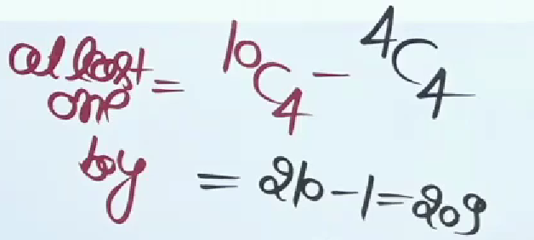
ANSWER

Slide 38
Question 15
How many different committees of 5 can be formed from 6 men and 4 women on which exactly 3 men and 2 women serve?
6
60
20
120
Notes:
Ans : D) 120

Slide 39
ANSWER
3 men can be selected from 6 men in 6C3 ways And 2 women can be selected from 4 women in 4C2 ways, =6C3×4C2
=20×6
=120

Slide 40
THANK YOU

